Slide 1

AI-Based Skin Allergy Detection and Personalized Healthcare Recommendation System Using Deep Learning
Third Review
Presented By :
Kaviyashree .K(23619244)
Poojasree . P.D(23619223)
Janani .R(23619210)
Internal Guide :
MRS.S.DIVYA BAIRAVI M.E.,(Ph.D)
ASSISTANT PROFESSOR
DEPARTMENT OF ARTIFICIAL INTELLIGENCE AND MACHINE LEARNING

Slide 2
ABSTRACT :
Skin conditions such as urticaria, eczema, psoriasis, and contact dermatitis often look alike in photographs, which makes it hard for a non-specialist to tell them apart. This paper describes DermaAI, a prototype that pairs an EfficientNetV2-B0 image classifier with a complete patient-facing workflow instead of stopping at a single predicted label. A user uploads a skin photo along with basic details and symptoms; the system returns the most likely condition together with a confidence score, a Grad-CAM heatmap that shows where the model looked, a rule-based severity rating built from six symptom questions, condition-specific food and clothing suggestions, a downloadable PDF report, and a list of nearby dermatologists. The interface works in both English and Tamil and accepts spoken symptoms as well as typed ones. In its current form the classifier takes 224×224 RGB input across four classes and reaches 85.80% test accuracy; this number still needs to be confirmed on a proper held-out set before the work is written up for a conference. The tool is meant for early, informal screening and patient education, and is not a substitute for a dermatologist's opinion.
Index Terms—Skin allergy detection, deep learning, EfficientNetV2-B0, transfer learning, image classification, Grad-CAM, explainable AI, personalized healthcare recommendation, severity assessment, Streamlit.

Slide 3
PROBLEM STATEMENT
Skin allergies are common and require early identification and appropriate care.
Traditional diagnosis mainly depends on dermatologists.
Access to dermatological services may be limited in some locations.
Existing AI-based systems mainly focus on detecting and classifying skin conditions.
They provide limited support after classification.
Patients may not have sufficient guidance about:
  Possible allergy triggers
  Suitable food
  Appropriate clothing
  Supportive skin care
Therefore, an integrated system is required that combines skin allergy detection with personalized recommendations and supportive features.

Slide 4
OBJECTIVES
To develop an AI-based skin condition detection system using skin images and patient details.
To classify skin conditions using a deep learning model and provide prediction confidence.
To use Grad-CAM to visualize the important areas influencing the AI prediction.
To assess symptom severity based on patient-reported symptoms and affected area.
To provide personalized recommendations for food, clothing, and supportive skin care.
To support voice-based symptoms, nearby dermatologist search, and patient report generation for better healthcare assistance.

Slide 5
LITERATURE REVIEW
No. | Paper | Year | Approach | Limitation
1 | Skin Disease Prediction Using Efficient-Net with Integrated Clinical Decision Support System | 2026 | EfficientNetB3 + transfer learning + clinical support | Does not specifically focus on personalized food and clothing recommendations for the four target allergies
2 | Skin Lesion Classification using EfficientNet B0 and B1 via Transfer Learning | 2024 | EfficientNet-B0/B1 + transfer learning | Mainly focuses on skin lesions and does not provide allergy-trigger or lifestyle recommendations
3 | LesNet: Automated Skin Lesion DCNN Classifier | 2024 | Transfer learning + augmentation | Focuses on lesion classification without personalized recommendations
4 | EffSVMNet: Efficient Hybrid Neural Network | 2024 | Hybrid deep-learning approach | Mainly focuses on classification performance
5 | Personalized Recommendation System to Handle Skin Cancer at Early Stage | 2025 | Detection + personalized recommendations | Focuses on skin cancer rather than the four target skin allergies

Slide 6
Proposed System
Patient Data Collection – Collects basic patient details and current skin-related symptoms.
Skin Image Analysis – Accepts a skin image and uses a deep learning model to predict the possible skin condition.
Severity Assessment – Evaluates symptom severity based on itching, redness, swelling, pain, affected area, and skin damage.
Explainable AI with Grad-CAM – Highlights the areas of the skin that influenced the model's prediction.
Personalized Recommendations – Provides condition-based suggestions for food, clothing, and supportive skin care.
Additional Healthcare Support – Includes voice-based symptom input, nearby dermatologist search, and patient report generation.

Slide 7



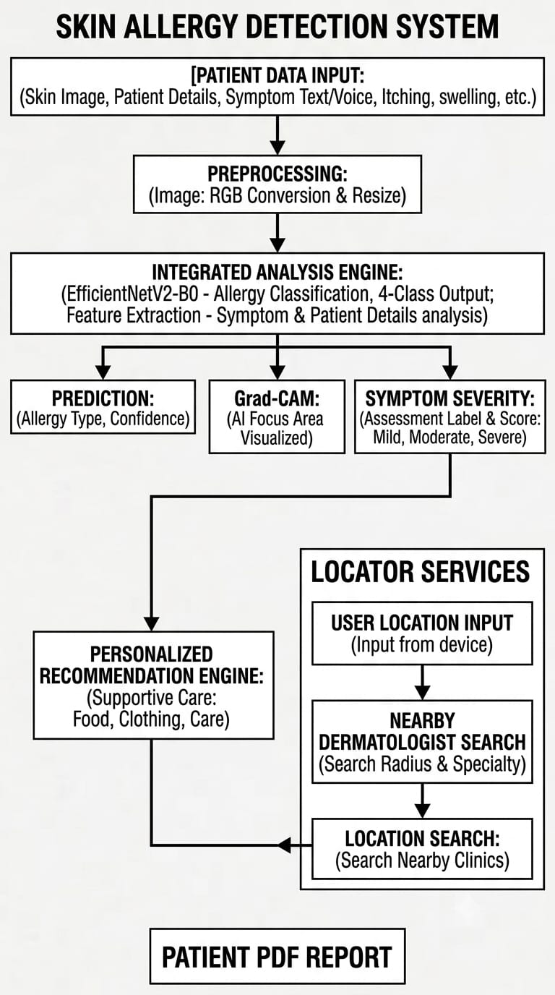
SYSTEM ARCHITECTURE

Slide 8
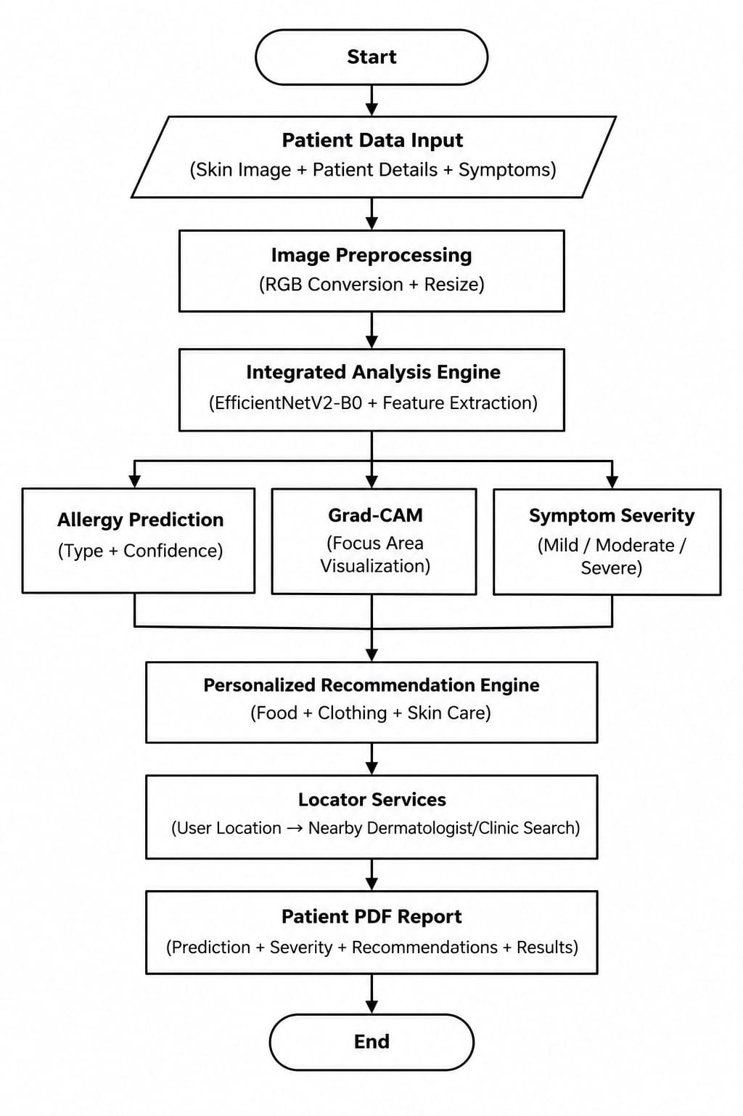
FLOW CHART

Slide 9
MODULES
Patient Management
Image Processing
Skin Condition Prediction
Severity Assessment
Personalized Recommendations
Patient Report Generation

Slide 10
Module - 1
Patient Management Module
Collects basic patient details such as Name, Age, Gender, Contact Number and previous allergy information.
Records the patient's current symptoms.
Saves the details for generating the patient report.
Module - 2
Image Processing Module
Allows the user to upload a skin image.
Converts the image into a suitable format for the AI model.
Resizes the image to 224 × 224 pixels before prediction.

Slide 11
Module - 3
Skin Condition Prediction Module
Uses the EfficientNetV2-B0 deep learning model.
Analyzes the uploaded skin image.
Predicts one of the supported conditions: Urticaria, Eczema, Psoriasis, or Contact Dermatitis.
Displays the prediction confidence.
Module - 4
Severity Assessment Module
Collects symptom severity information such as itching, redness, swelling, affected area and pain.
Calculates an overall severity level and severity score.
Helps provide additional information along with the AI prediction.

Slide 12
MODULE - 5
Personalized Recommendations Module
Provides recommendations based on the predicted skin condition.
Gives food recommendations.
Gives clothing recommendations.
Provides supportive-care information and precautions.
MODULE - 6
Patient Report Generation Module
Generates a PDF patient report.
Includes patient details, uploaded skin image, predicted condition and confidence.
Provides the report as a downloadable file for future reference.

Slide 13
MODULE - 7
Web Application Module
Provides the complete application interface using Streamlit.
Integrates the patient input, image prediction, severity assessment and recommendations.
Also provides features such as voice symptom input and nearby dermatologist search.

Slide 14
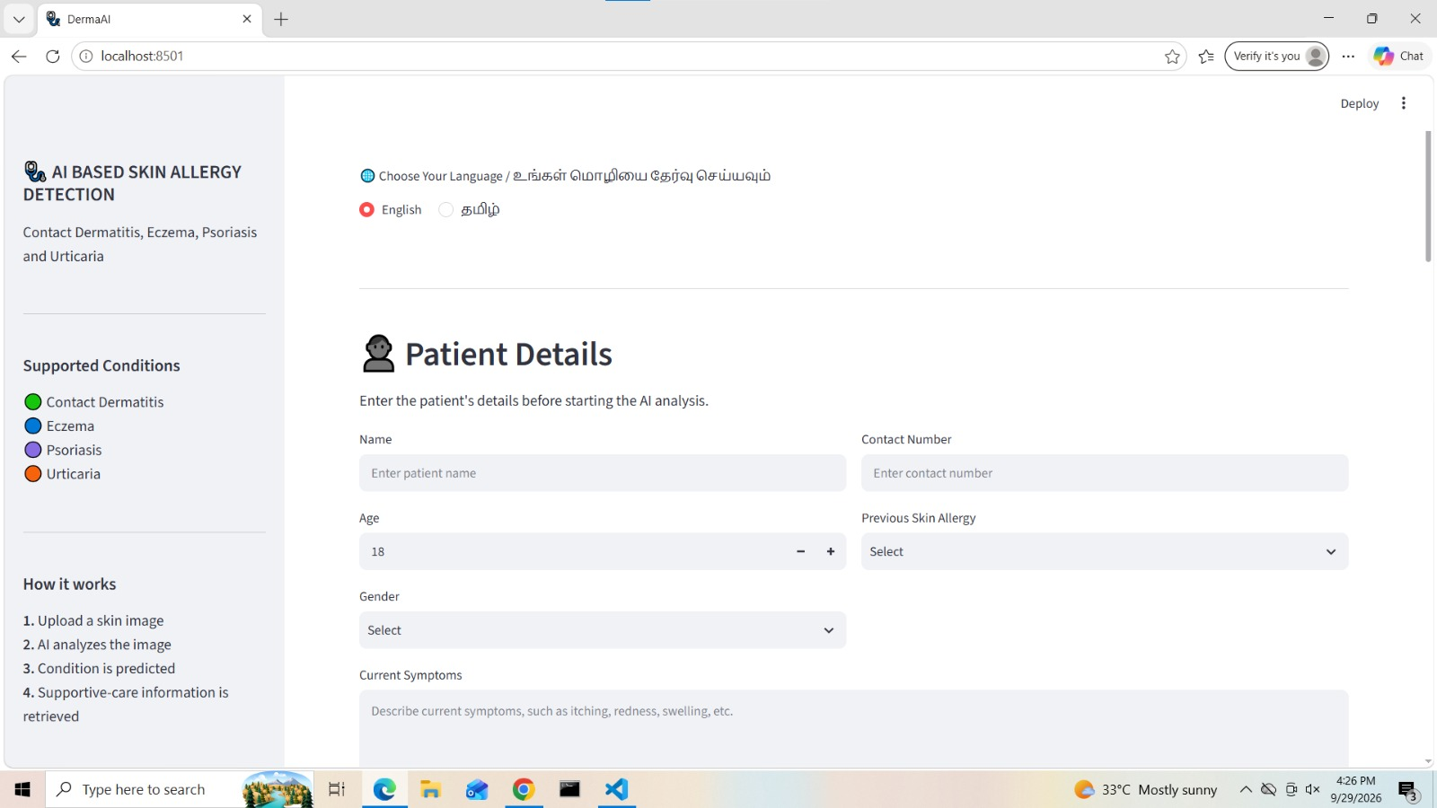
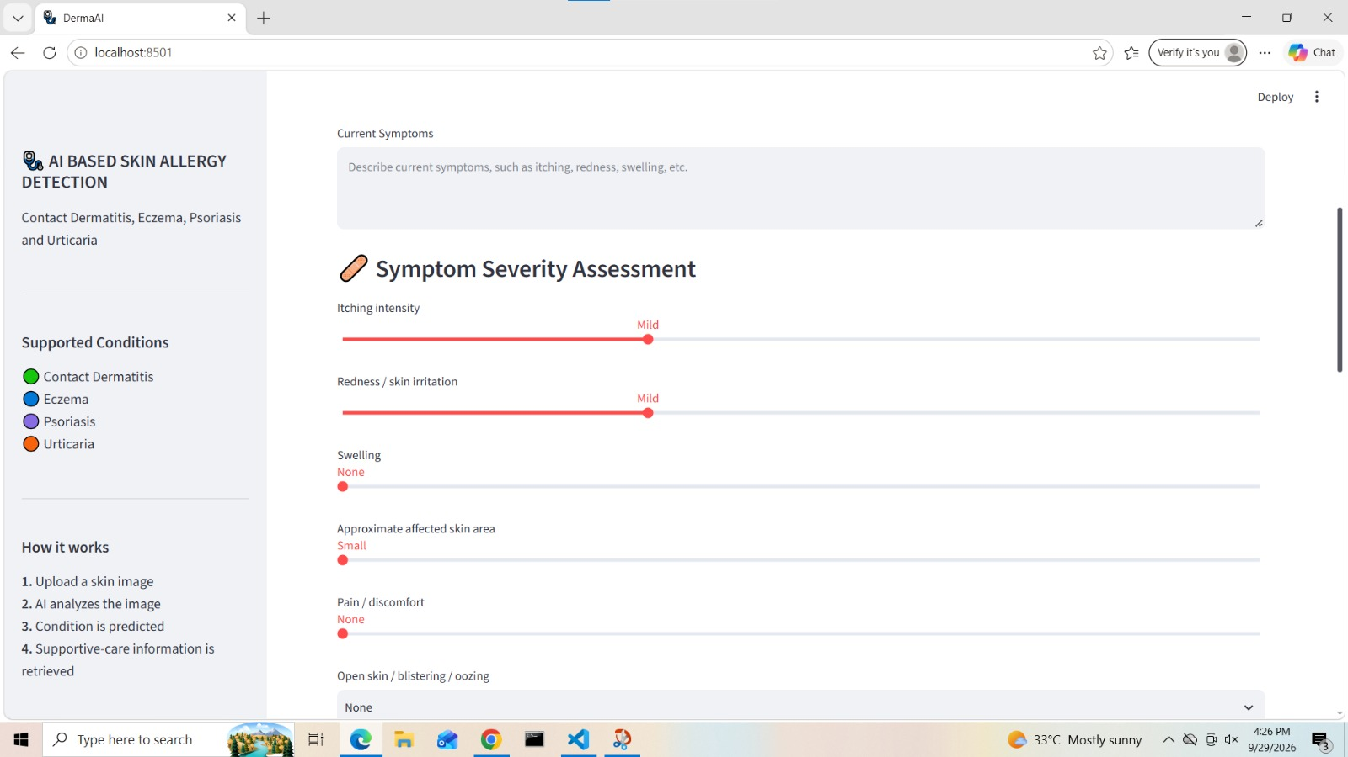
IMPLEMENTATION

Slide 15
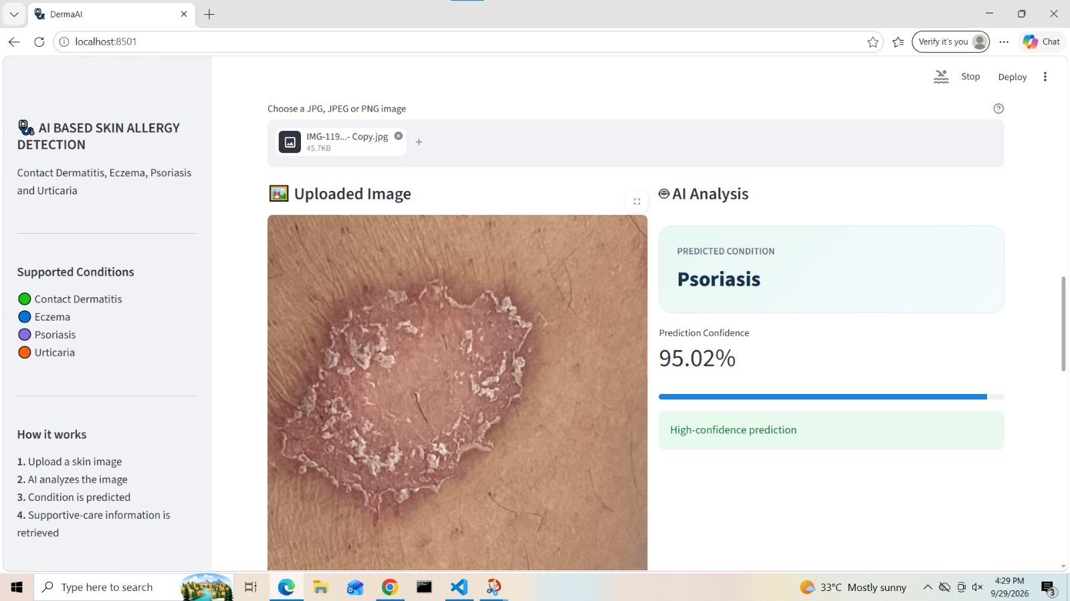
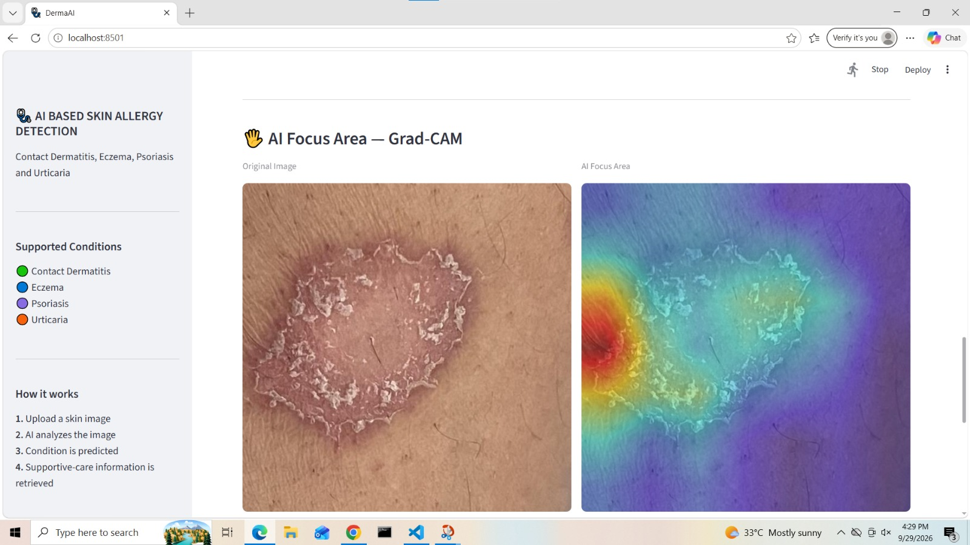

Slide 16
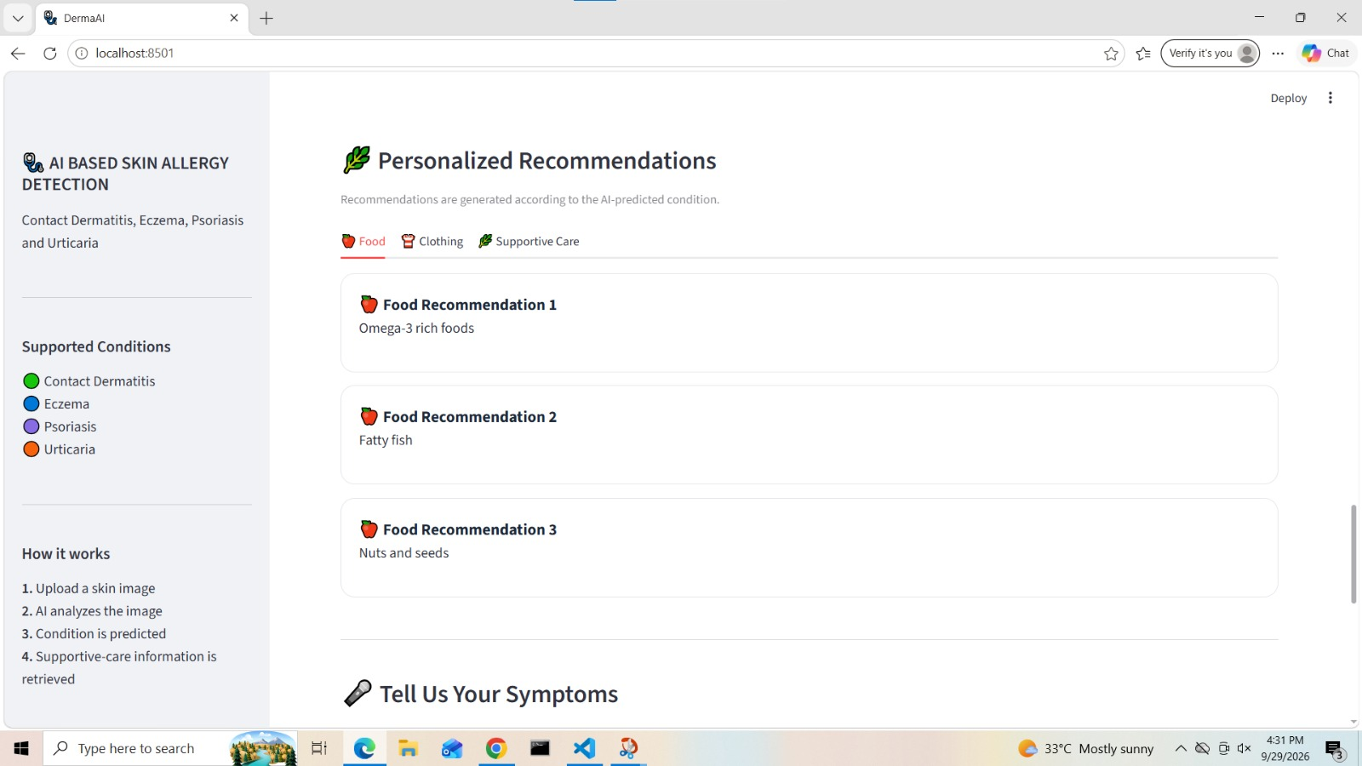
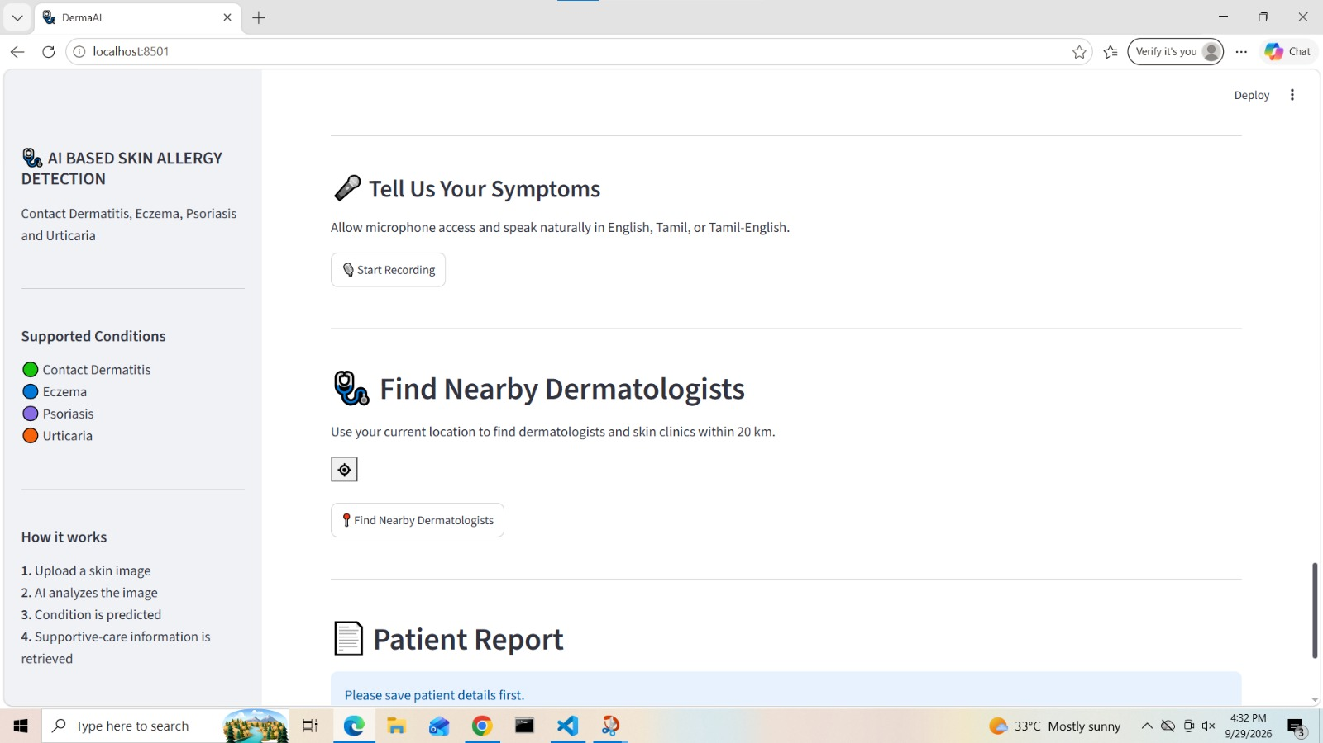

Slide 17
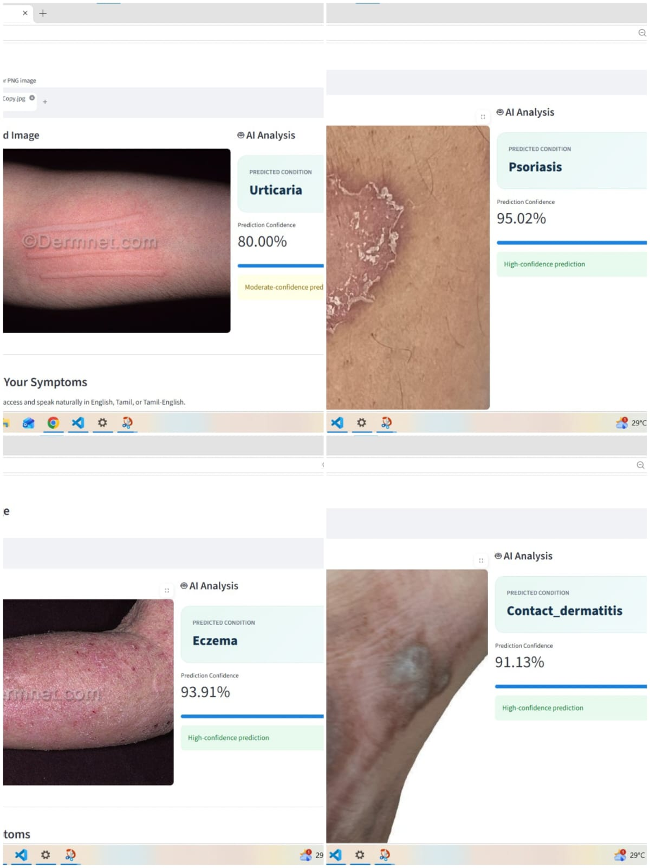
OUTPUT

Slide 18
Software Requirements
Software | Purpose
Python | Main programming language
TensorFlow / Keras | Loading and running the deep-learning model
EfficientNetV2-B0 | Skin allergy classification
Streamlit | Web application
NumPy | Image-array processing
Pillow (PIL) | Image loading and preprocessing
Pandas | Prediction-history management
VS Code | Development environment
Windows OS | Development platform

Slide 19
Hardware Requirements
Laptop
Intel Core i5 or equivalent processor
8 GB RAM or above
10 GB storage or above
GPU optional for model training

Slide 20
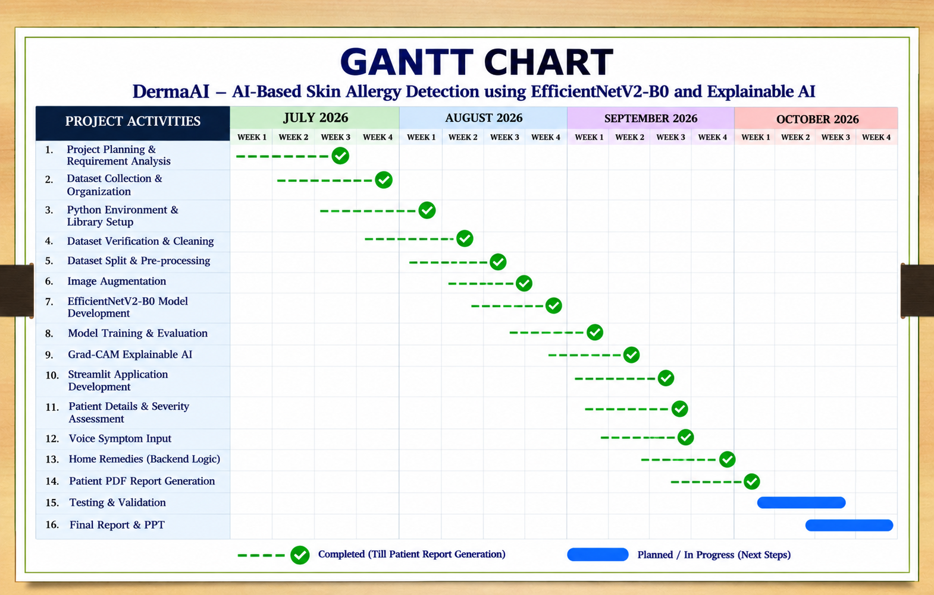

Slide 21
Results and Discussion
The developed system successfully accepts skin images as input through the Streamlit web application and performs the required image preprocessing before prediction.
• The trained EfficientNetV2-B0 with Transfer Learning classifies the uploaded image into one of the four target categories: Urticaria, Eczema, Psoriasis, and Contact Dermatitis.
• The system performs severity assessment based on symptoms such as itching, redness, swelling, affected area, pain, and skin damage.
• The system uses Grad-CAM visualization to display the AI focus area of the uploaded skin image, helping users understand the region considered during prediction.
• After classification, the system provides personalized food, clothing, and supportive-care recommendations based on the predicted condition.
• The Streamlit web application also provides voice symptom input, nearby dermatologist search, and downloadable patient report generation, making the system more comprehensive and user-friendly.

Slide 22
Challenges faced
Dataset Collection & Quality (dataset is not easily available)
Collecting a suitable dataset containing sufficient and properly labelled images for all four skin allergy classes was challenging
Skin images can differ in size, format, lighting, background, and quality, so preprocessing them into a consistent 224 × 224 RGB format was necessary before model prediction.
Model Training & Classification
Training the EfficientNetV2-B0 with Transfer Learning and obtaining reliable classification across Urticaria, Eczema, Psoriasis, and Contact Dermatitis requires appropriate data preparation and model tuning.
Connecting each predicted allergy with relevant possible causes, food recommendations, and clothing suggestions required organizing condition-specific information in the system.
Web Application & History Management .

Slide 23
FUTURE WORK
Dataset Expansion
Increase the number of skin images.
Include more diverse skin tones.
Include different lighting and image-quality conditions.
Model Improvement
Experiment with advanced deep-learning models.
Apply further fine-tuning.
Improve generalization.
Advanced Personalization
Analyze more patient-specific factors.
Improve trigger analysis.
Provide more personalized recommendations.
Application Enhancement
Improve food and clothing recommendations.
Extend to mobile platforms.
Enable real-time use.
Improve dermatologist-support functionality.

Slide 24
Reference
Y. B. Nawale and S. A. Gade, “Skin Disease Prediction Using Efficient-Net with Integrated Clinical Decision Support System,” International Journal of Engineering Research & Technology (IJERT), vol. 15, no. 1, 2026. base paper
S. S. Han et al., “Augmented Intelligence Dermatology: Deep Neural Networks Empower Medical Professionals in Diagnosing Skin Cancer and Predicting Treatment Options for 134 Skin Disorders,” Journal of Investigative Dermatology, vol. 140, no. 9, pp. 1753–1761, 2020. base paper
M. Harangi, “Skin Lesion Classification with Ensembles of Deep Convolutional Neural Networks,” Journal of Biomedical Informatics, vol. 86, pp. 25–32, 2018. base paper
A. Esteva et al., “Dermatologist-Level Classification of Skin Cancer with Deep Neural Networks,” Nature, vol. 542, no. 7639, pp. 115–118, 2017. base paper
M. Tan and Q. V. Le, “EfficientNet: Rethinking Model Scaling for Convolutional Neural Networks,” Proceedings of the 36th International Conference on Machine Learning (ICML), 2019. base paper

Slide 25
THANK YOU

